Slide 1
StringBuffer
Java StringBuffer class is used to create mutable (modifiable) string. The StringBuffer class in java is same as String class except it is mutable i.e. it can be changed.
Java StringBuffer class is thread-safe i.e. multiple threads cannot access it simultaneously. So it is safe and will result in an order.
StringBuffer represents growable and writable character sequence.

Slide 2
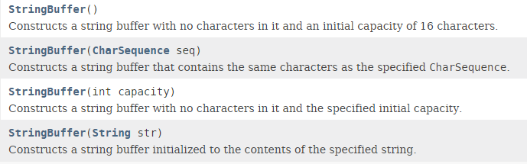
StringBuffer
Constructors

Slide 3
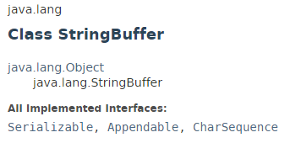
StringBuffer

Slide 4
StringBuffer
https://docs.oracle.com/javase/8/docs/api/index.html?java/lang/String.html

